Slide 1

HISTORY OF THE EMERGENCE OF INDEPENDENT BANGLADESH
Dr. Md. Abdul Alim
B. A (Hon’s), M. A (History), M. Phil (Raj), Ph. D (Raj)
Email:doctorabdulalim64@gmail.com
Cell: +880 01718-787466

Slide 2

DIWANI RIGHTS
An agreement made with the Mughal Emperor in the late 18th century gave the British East India Company access to the Diwani rights. The word “Diwani right” refers to the authority to manage and collect taxes in a specific area. The agreement gave the Company authority to levy taxes and manage funds throughout the Mughal Empire’s at-the-time provinces of Bengal, Bihar, and Orissa.
Although there are conflicting reports of the actual circumstances surrounding the treaty’s signing, it is generally acknowledged that the Company acquired the Diwani rights through a combination of political scheming and military force. The acquisition of these rights significantly increased the British Empire’s authority and influence in India and opened the door for further British colonization of the continent.

Slide 3

IMPACT OF DIWANI RIGHTS
Under British control, the impact of the Diwani privileges had a significant effect on the British presence in India. The following are a few of the effects:
Increased Authority: The Diwani powers provided the British East India Company considerable authority over the regions in which it was given the jurisdiction to levy taxes and handle finances. As a result, the Company was able to take control of more portions of India and solidify its hegemony over the continent.
Financial Gains: The British East India Company was able to rake in money thanks to the Diwani privileges in some of the richest regions of India at the time, including Bengal, Bihar, and Orissa. The Company’s financial resources significantly increased as a result, and it was able to keep its military presence in India.

Slide 4

IMPACT OF DIWANI RIGHTS
British Dominion: The Diwani privileges, along with other agreements and treaties the British established with Indian kings and princes, helped the British to firmly establish their rule over India. This effort took a big stride forward with the purchase of the Diwani rights, which opened the door for more British colonization of the subcontinent.
Reduced Mughal Influence: The granting of the Diwani powers signaled the Mughal Empire‘s loss of strength and influence in India. As a result of the Mughal Emperor granting the British these privileges, which was viewed as a sign of weakness, the British began to systematically annex more and more Mughal territory.
The Diwani rights had a major influence on the British presence in India and contributed to the establishment of British sovereignty over the continent overall. The Mughal Empire’s authority was diminished while the rights gave financial rewards, greater power, and influence, and enabled the cementing of British rule.

Slide 5
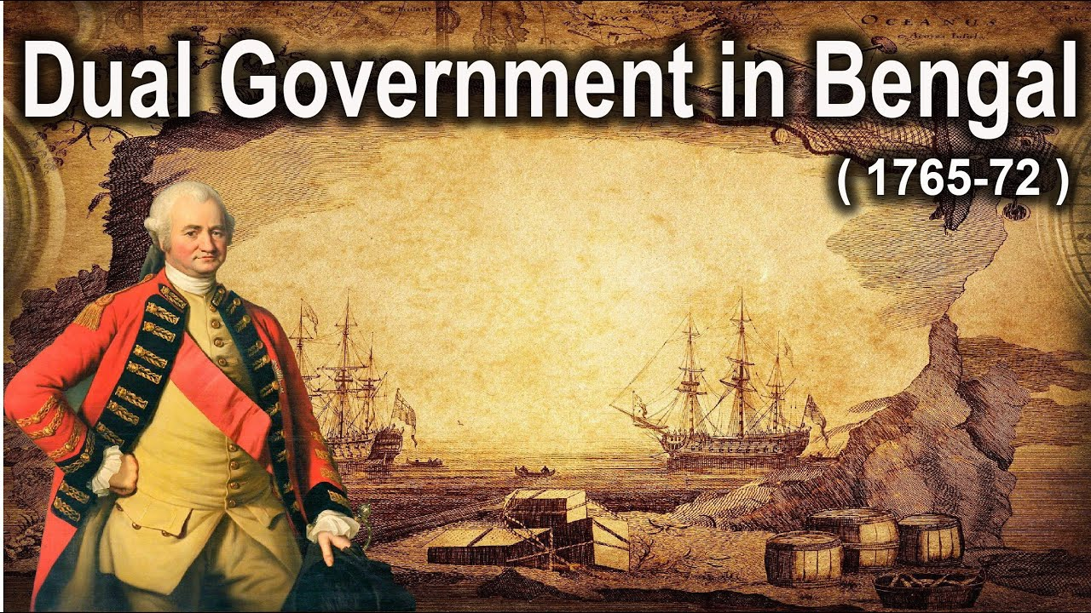
DUAL GOVERNMENT OF BENGAL (1765-1772)
Dual Government of Bengal was a system of Government established by Robert Clive following the Treaty of Allahabad (1765).
The British East India Company obtained the actual power; whereas the responsibility and charge of administration was entrusted to the Nawab of Bengal. Under this dual system of governance, the British administration acquired both the functions of the Diwani and Nizamat of Bengal.
Diwani = Revenue and Civil Administration
Nizamat= Police and Criminal Administration

Slide 6
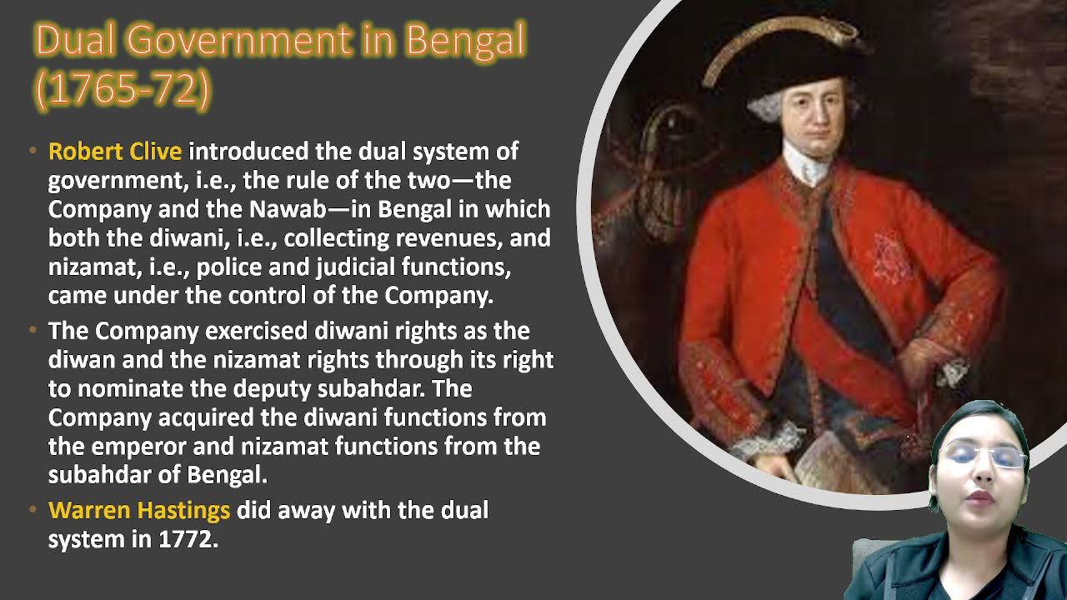
DUAL GOVERNMENT OF BENGAL (1765-1772)
Diwani was acquired from the Mughal emperor and Nizamat from the Nawab of Bengal.
As the diwan, the Company was authorized to collect revenues of the province, while through the right to nominate the deputy subahdar it was in a position to control the nizamat or the police and judicial powers. The deputy subahdar could not be removed without the consent of the Company. However, at this point, the Company was neither willing nor able to collect the revenue directly.

Slide 7
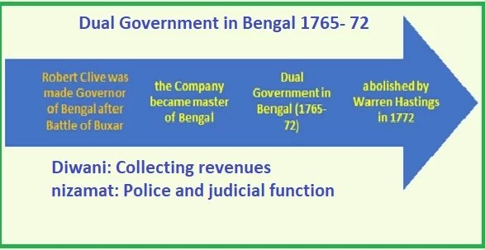
DUAL GOVERNMENT OF BENGAL (1765-1772)
Hence Company appointed two deputy diwans for exercising diwani functions Reza Khan for Bengal and Raja Sitah Roy for Bihar. Mohammad Reza Khan also functioned as deputy Nizam. In this way, the whole administration of Bengal was exercised through an Indian agency, although the actual authority rested with the Company.
The dual government system held a great advantage for the British had power without responsibility. The Nawab and his officials were responsible for administration, but they had no power to discharge it. The Nawab was merely a puppet in the hands of the British Government of India. The Nawab of Bengal province was under their dominion and depended upon them for his very existence.

Slide 8

DEMERITS OF THE DUAL GOVERNMENT
The Dual Government of Clive has been criticized in various ways. It led to disastrous results.
Administration was badly affected: Power was divorced from the responsibility. The British had power and money while the Nawab had neither power nor money. Nawab had only the responsibility of running the administration. The Nawab failed to manage the administration smoothly with a small annual grant of rupees 50 lakh.
The company tried to improve its lot by the revenue it collected from Bengal, Bihar, and Orissa. The Nawab could not do any work of public utility due to the paucity of funds. The Nawab also had no power to enforce the law.

Slide 9
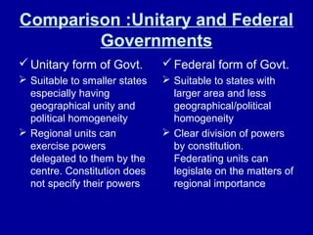
DEMERITS OF THE DUAL GOVERNMENT
As a result, lawlessness prevailed in most parts of Bengal. The cases of theft and robbery increased by lips and bounds. The common people had to suffer a lot due to want of justice. They suffered to such an extent that they preferred even to leave their home and heart.
Deterioration of Agriculture: The condition of agriculture in Bengal gradually deteriorated under the Dual Government of Clive. The power of collection of revenue rested in the hands of the company only. So, the Nawab could not make any provision like irrigation for the development of agriculture in Bengal. He also failed to advance loans to needy farmers due to a shortage of funds. The great famine of 1770 was an indirect outcome of the above difficulties.
The downfall of agriculture under the Dual Government ultimately led to the downfall of the Company’s income. The English Company became apathetic to agriculture in Bengal which led to loss of production in the field. It ultimately resulted in a decrease in revenue collection.

Slide 10
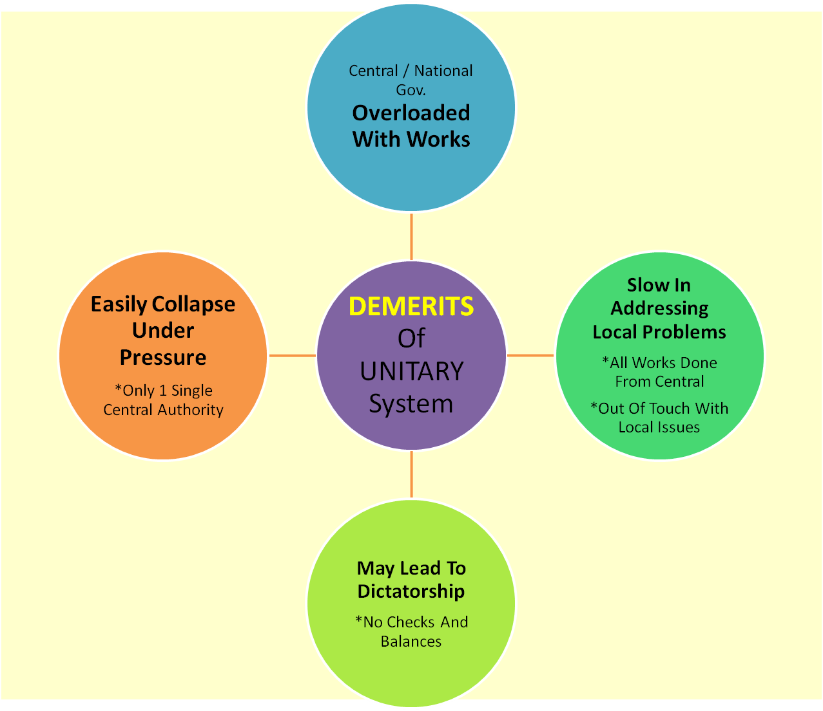
DEMERITS OF THE DUAL GOVERNMENT
Rapid increase in Private trade: The poor administration in Bengal led to the rapid increase of private trade. The servants of the East India Company carried on trade and commerce privately without paying any tax. They earned a lot of profit out of this illegal trade. But on the other hand, the merchants of Bengal suffered a lot, because they were overburdened with tax. Thus, the Dual Government dealt a terrible blow to the local trade and commerce.
Increase in Oppression: The servants of the Nawab became wayward and oppressive when they came to know that the Nawab was a great puppet in the hands of the English company. This led to the suffering of the people of Bengal. It was another drawback of the Dual Government.

Slide 11
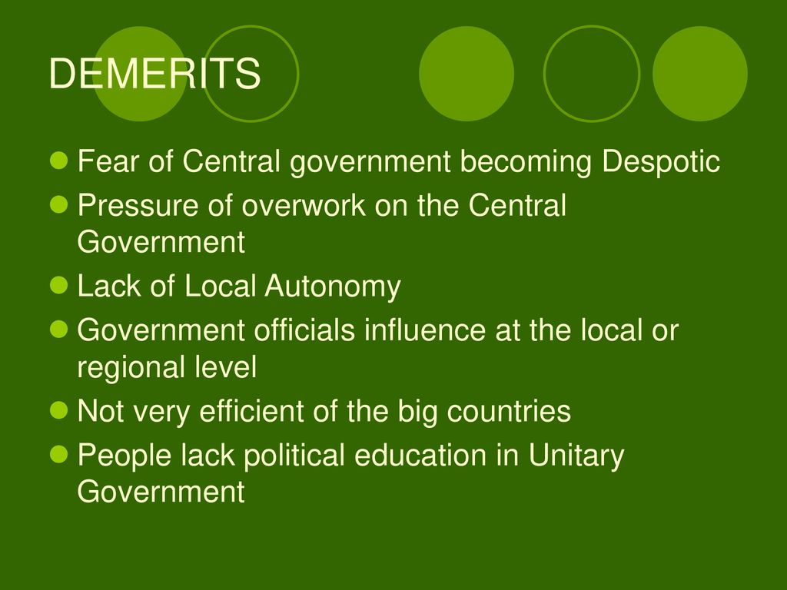
DEMERITS OF THE DUAL GOVERNMENT
Downfall of Local Industries: The Dual Government of Clive was further responsible for the downfall of local industries. The company’s people forced the local weavers to work exclusively for the company. Many other small local industries also were brought under the control of the company.
Ineffective Justice System: People failed to get proper justice under the Dual system of Government. The judges of the Nawab were influenced by British authority because the latter played a vital role in their appointment. Thus, the judges failed to give an impartial verdict which was detrimental to the interest of the public.

Slide 12

THE GREAT BENGAL FAMINE OF 1770
A disastrous famine affected the lower Gangetic Plains of India including the regions of Bengal and Bihar between 1769 and 1773 where 1/3rd of the population perished. An estimated 10 million people died of starvation and famine-triggered epidemics that also affected the regions of Assam, Odisha, Jharkhand, and Bangladesh. The territory was then ruled by the British East India Company.

Slide 13

THE GREAT BENGAL FAMINE OF 1770
The famine is one of the many famines and famine-triggered epidemics that devastated the Indian subcontinent during the 18th and 19th centuries. It is usually attributed to a combination of weather and the policies of the East India Company. The start of the famine has been attributed to a failed monsoon in 1769 that caused widespread drought and two consecutive failed rice crops. The devastation from war, combined with exploitative tax revenue policies of the East India Company after 1765 crippled the economic resources of the rural population. However, modern scholarship has suggested that the effect of taxation was marginal.

Slide 14

CAUSES OF THE GREAT BENGAL FAMINE OF 1770
After the Battles of Plassey and Buxar, the British East India Company acquired the Diwani rights over Bengal.
The Nawab was only a nominal head with the real power resting under the company’s head.
The company was only interested in maximizing revenue and profits for itself while the plight of the local farmers and others was completely neglected.
Before the company’s rule, the tax rate on land revenue was only about 1/10th of the agricultural produce. But the company increased its overnight to 50% of the produce.

Slide 15
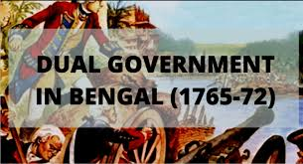
CAUSES OF THE GREAT BENGAL FAMINE OF 1770
The farmers, who had previously stored excess produce for a lean season (they had excess because of the lower tax), were not permitted to store produce, and they could not store too, because of the terrible tax regime under the English.
The British forced farmers to harvest cash crops like poppy and indigo for export rather than food crops like paddy. This resulted in a shortage of grains for the people.
There was a minor shortage of crops in 1768 which was not an alarming situation.
But in 1769, there was a monsoon failure followed by severe drought. Starvation deaths started in 1769, but the company officials ignored this situation.

Slide 16

CAUSES OF THE GREAT BENGAL FAMINE OF 1770
By 1770, the death count was increasing and almost 10 million people fell victim to this man-made devastation.
The company continued to collect taxes from farmers who could pay by further increasing the tax rate to make up for the loss in agricultural revenue due to the famine.
This famine was caused, to a large extent, by the company’s tax and revenue policies, and the apathy of the company officials to rising starvation.

Slide 17
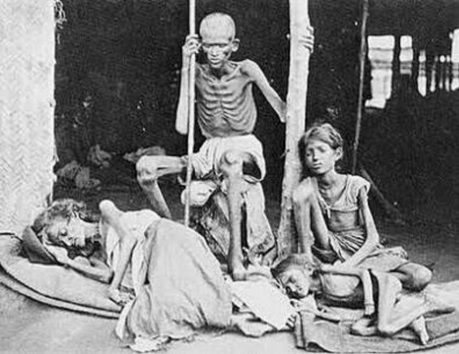
RESULTS OF THE FAMINE
The famine would have far-reaching consequences that would not only change the Indian subcontinent but even the world forever:
The famine situation soothed by 1770 with good rainfall but not before claiming 1/3rd of the local population.
Large swathes of land were depopulated as a result of the famine.
Many agricultural lands became jungles for decades as a result of this famine.
This also increased the menace of bands of Thugee in Bengal.

Slide 18

RESULTS OF THE FAMINE
Globally, the profit of the East India Company increased from fifteen million rupees in 1765 to thirty million in 1777.
Despite the soar in profits, the company continued to suffer financially and influenced Parliament to pass the Tea Act in 1773.
The Act allowed direct shipment of tea to the American colonies, without the payment of taxes. This infuriated the local merchants to the extent that they began protesting against this measure. One such protest was the Boston Tea Party of 1773.
The aftermath of the protest would eventually lead to a series of events that would culminate in the 1776 American Revolution.

Slide 19


